Slide 1
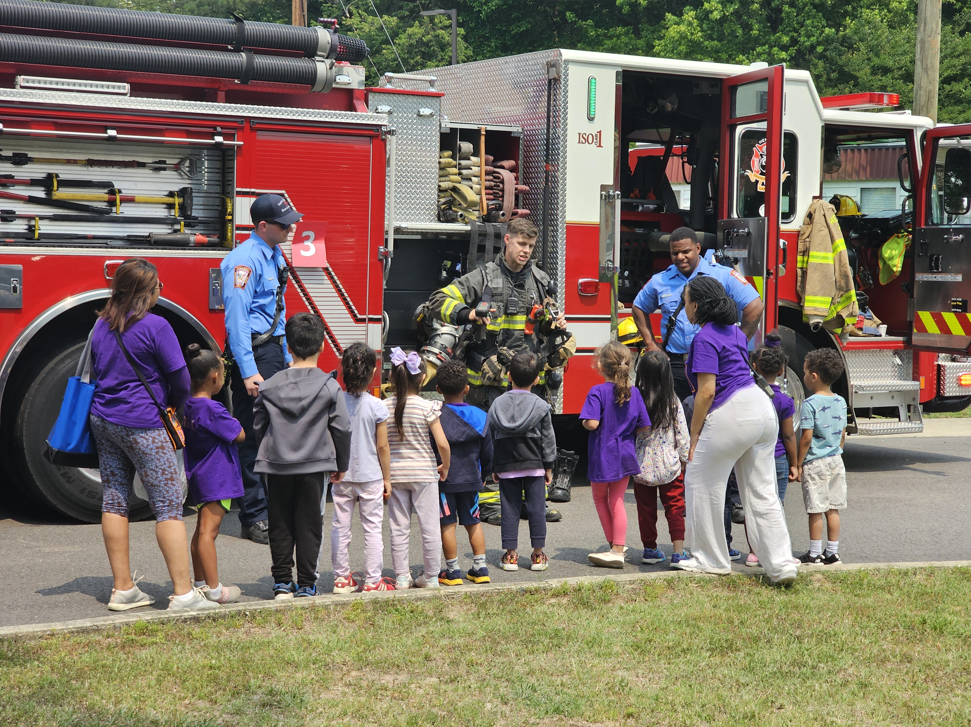
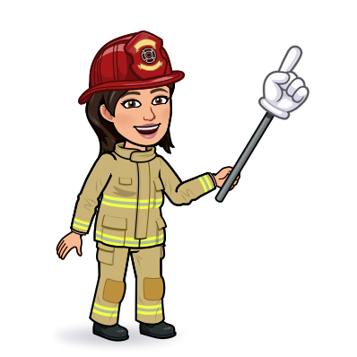
2nd & 3rd Grade
Fire Safety

Slide 2
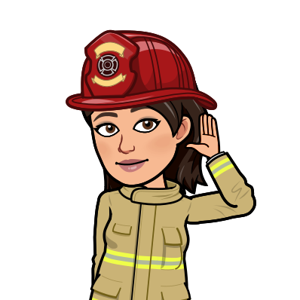
Listen to the Sounds of Fire Safety.
Know WHAT to do when you hear the BEEP-BEEP-BEEP!
The Sounds of Fire Safety!

Slide 3
Home Fire Dangers
Learn how to
“Be Safe”
in the kitchen.
Can you
Detect the Dangers?

Slide 4
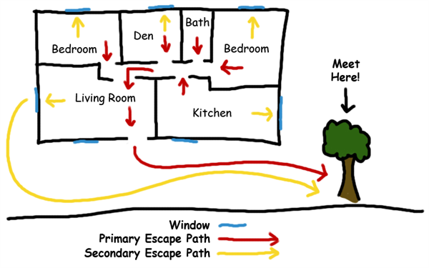
Home Fire Escape Plan
What should your plan include?

Slide 5
Home Fire Drills
How often should your family have a home fire drill?
How many minutes should it take for your family to finish a home fire drill?

Slide 6
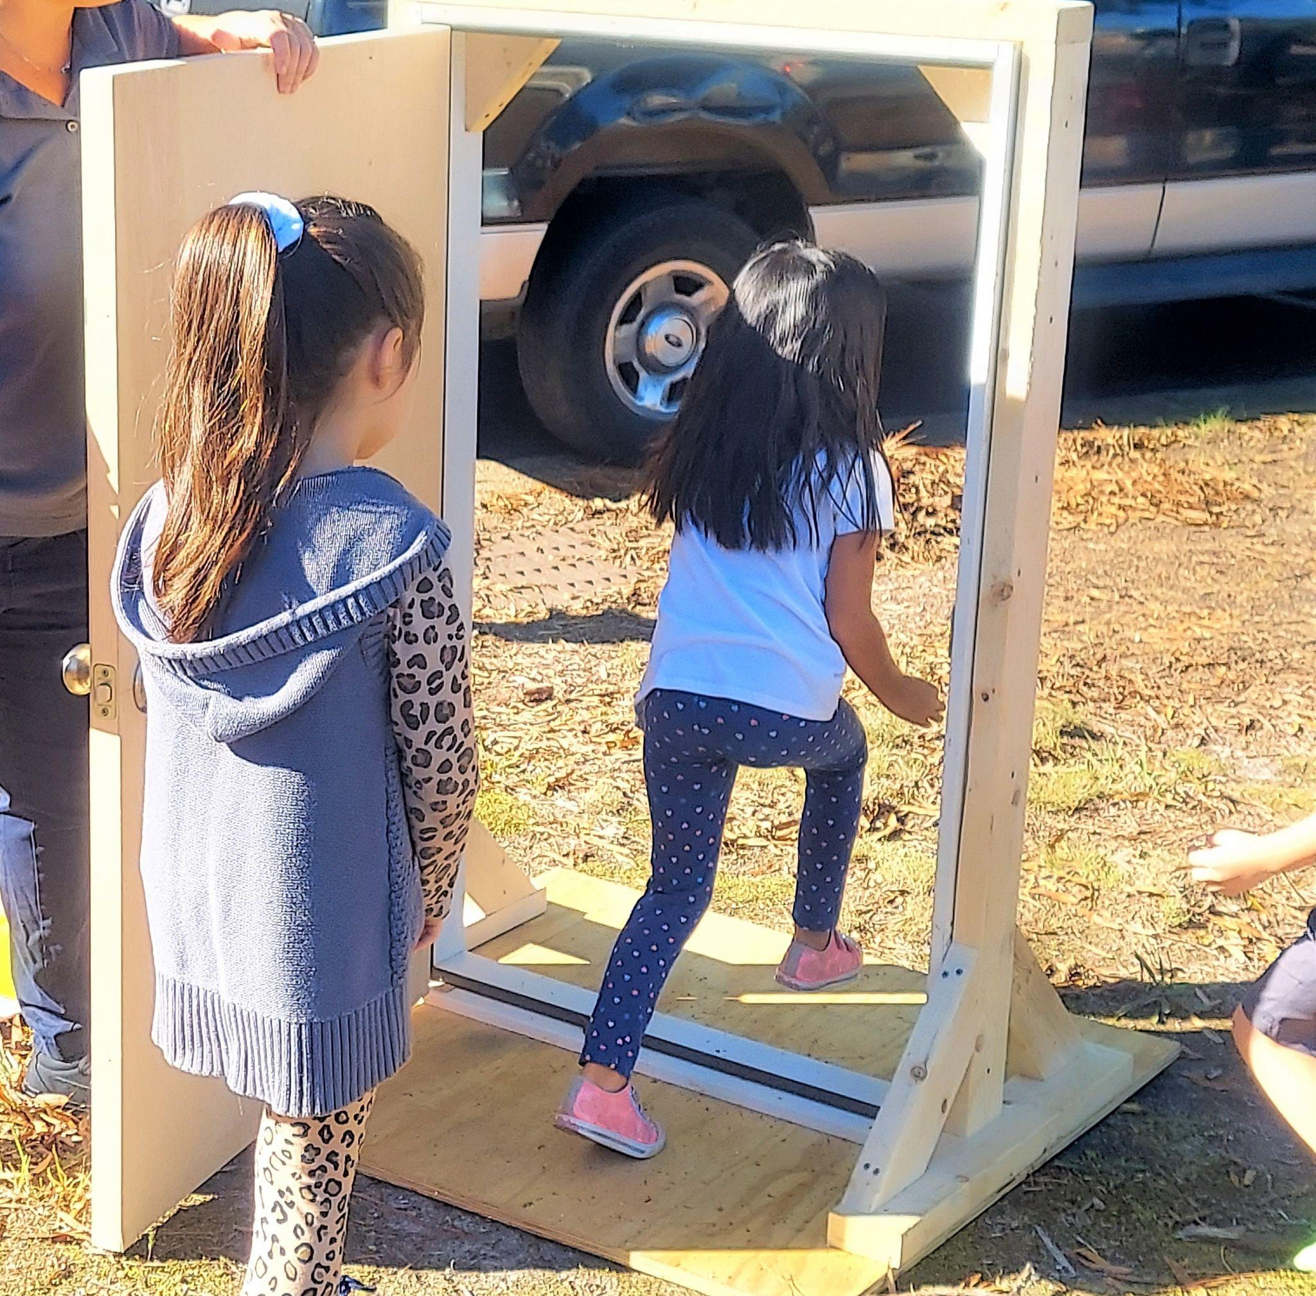
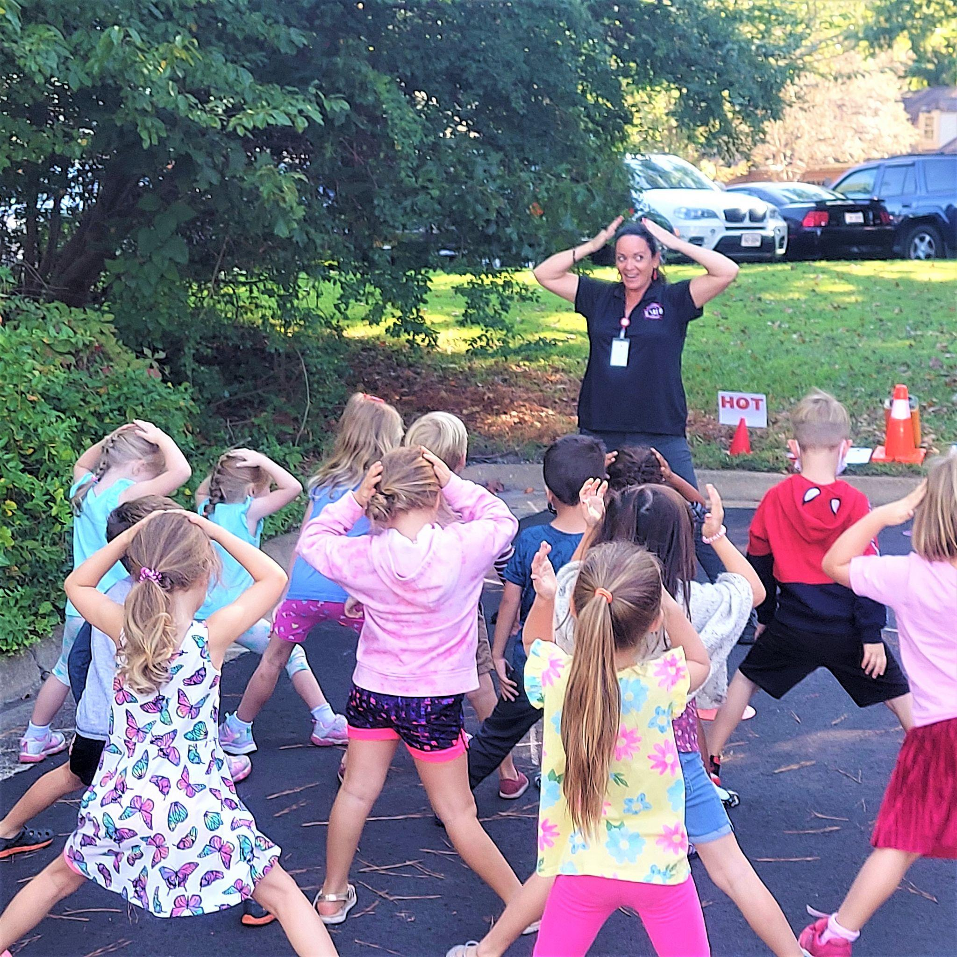
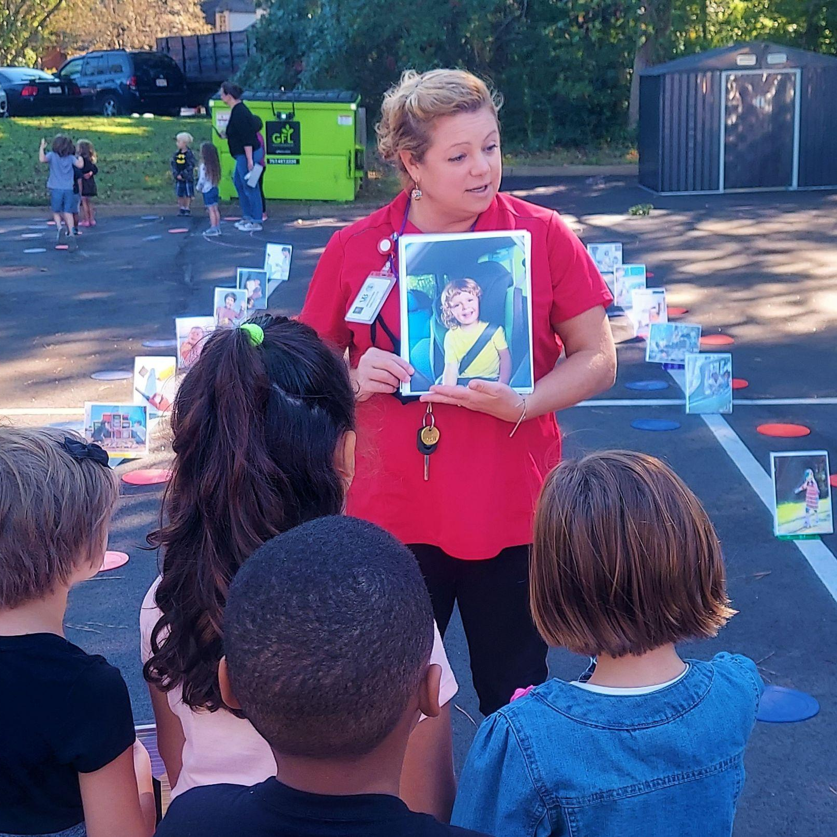
Pre-Lesson Complete!
Now you are ready to practice FIRE SAFETY with Henrico Firefighters! See you soon!

